Slide 1
Using SVM (Support vector machine) and KNN (k-nearest neighbors algorithm) Classifier Performing Analysis on a Six Class Audio Data Set
Nitesh V
01JST19PDS010
Mtech in Data Science

Slide 2
Introduction.
There are a variety of musical instruments where each instrument produces a different sound.
The human ability to distinguish between musical instruments from large data has been a subject of investigation for a number of year
Musical instrument classification is very important task for an musical information retrieval system.
Classification of musical instruments has many problems due to Multidimensional nature of musical instruments i.e. one instrument can belong to more than one instrument family

Slide 3
This system is designed to solve the problems in musical instrument classification by using the SVM(Support Vector Machine), KNN (k-nearest neighbors algorithm) classifiers.

Slide 4
Literature Survey.
TITLE | PROPOSED WORK IN THE PAPER | METHODS USED | CONSTRAINTS
Use of hierarchical taxonomies for musical instrument recognition on solo recording | Consist of techniques of Audio pre-processing , Segmentation , feature extraction and classification of recording | Support Vector Machine(SVM) | Implemented only for solo recordings
Pattern-recognition technique to the classification of musical instrument tones within a taxonomic hierarchy | Classification of audio files on basis of the pattern | KNN clustering algorithm

Slide 5
TITLE | PROPOSED WORK IN THE PAPER | METHODS USED | CONSTRAINTS
Musical Instrument Identification Using SVM , MLP& AdaBoost with Formal Concept Analysis. | Instrument identification by using the three algorithms | SVM , MLP& AdaBoost

Slide 6
Steps of Implementation
The system consist of three steps
I) Taking an already present data set
II) Classification of musical instrument
i) Applying SVM and KNN
III) Analysis of The result

Slide 7
Methodology.
KNN : K-nearest neighbors algorithm.
k-NN is a type of instance-based learning, or lazy learning, where the function is only approximated .
The algorithm basically searches for the nearest class of a given Input data.
The process of classification basically takes place on the value determined for K

Slide 8
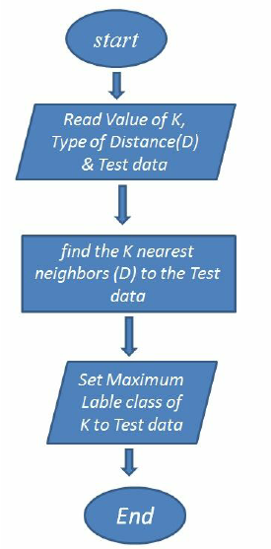
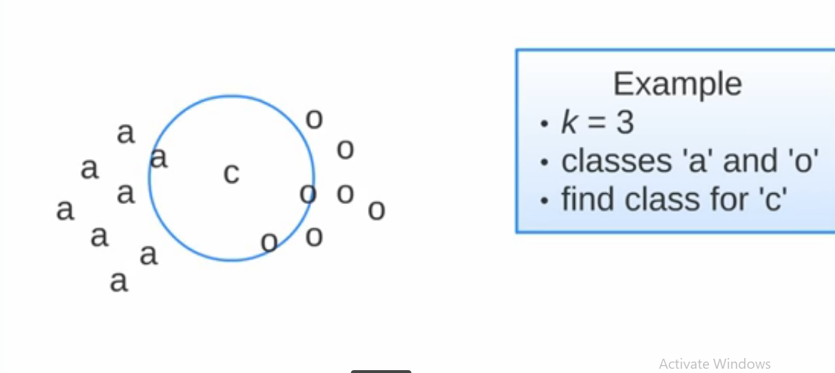
KNN Flowchart.

Slide 9
SVM(Support Vector Machine).
SVM is one of the classifiers.
Support vector machine(SVM) are supervised learning model algorithms. It is mostly used in classification problems.
In this algorithm, each data item is plotted as a point in n-dimensional space.
Mapping of inputs into high-dimensional feature spaces.

Slide 10
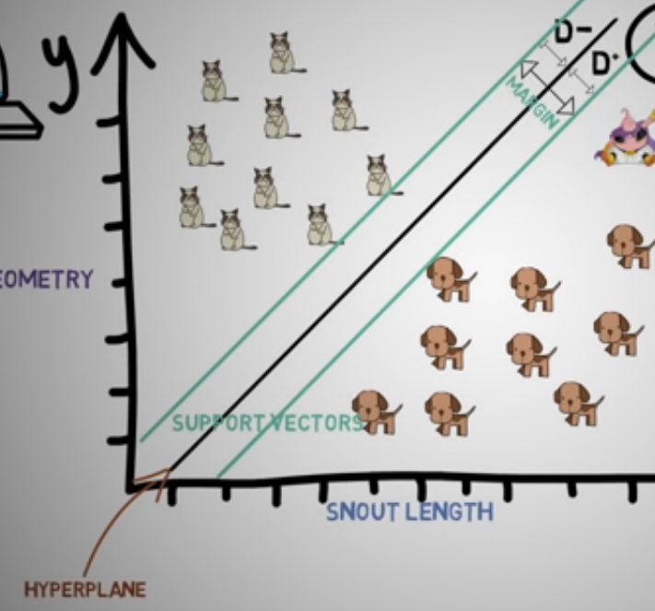

Slide 11
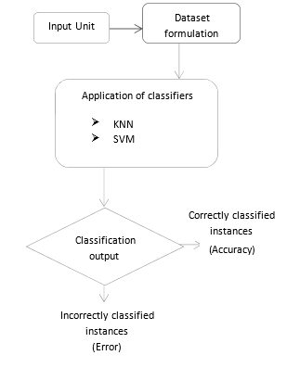
Program Flow.

Slide 12


Results.
Precision and Accuracy of KNN
Precision and Accuracy of SVM

Slide 13
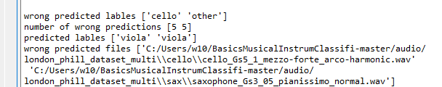
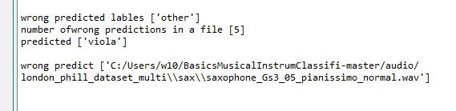
Wrong predicted files in KNN
Wrong predicted files in SVM

Slide 14
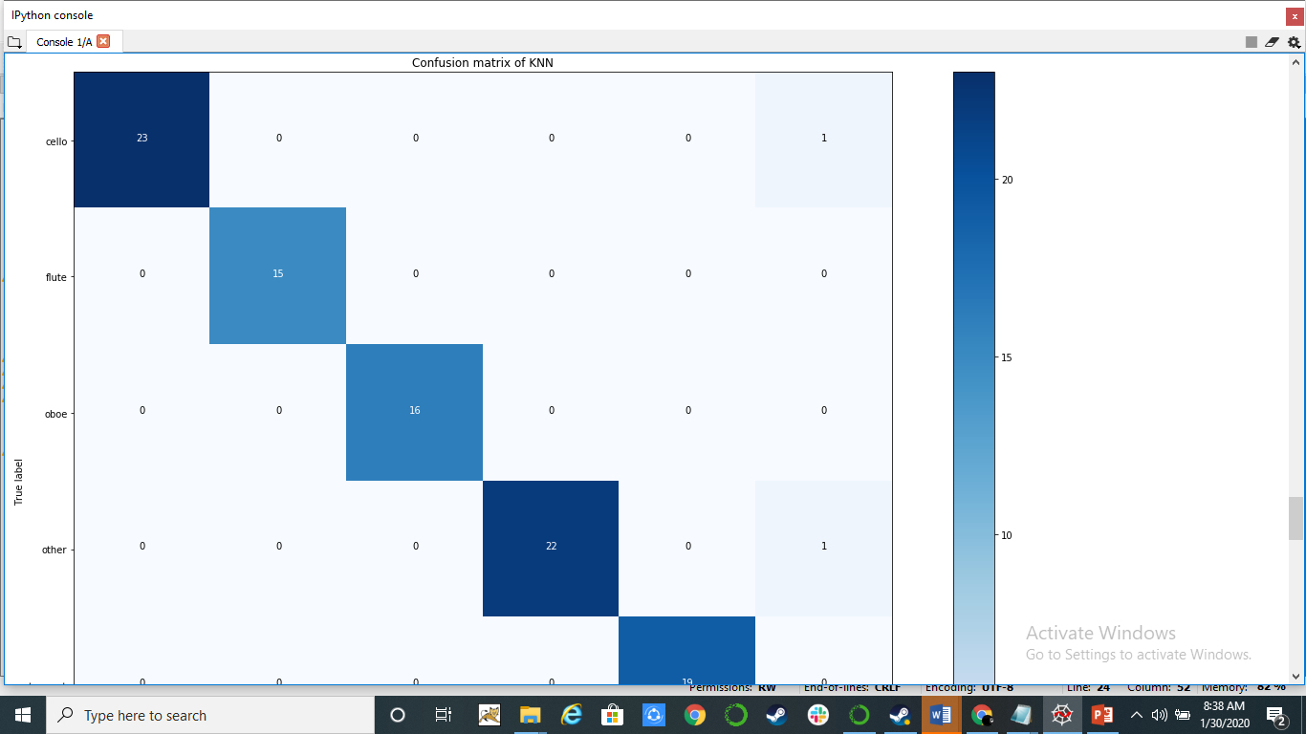

Slide 15
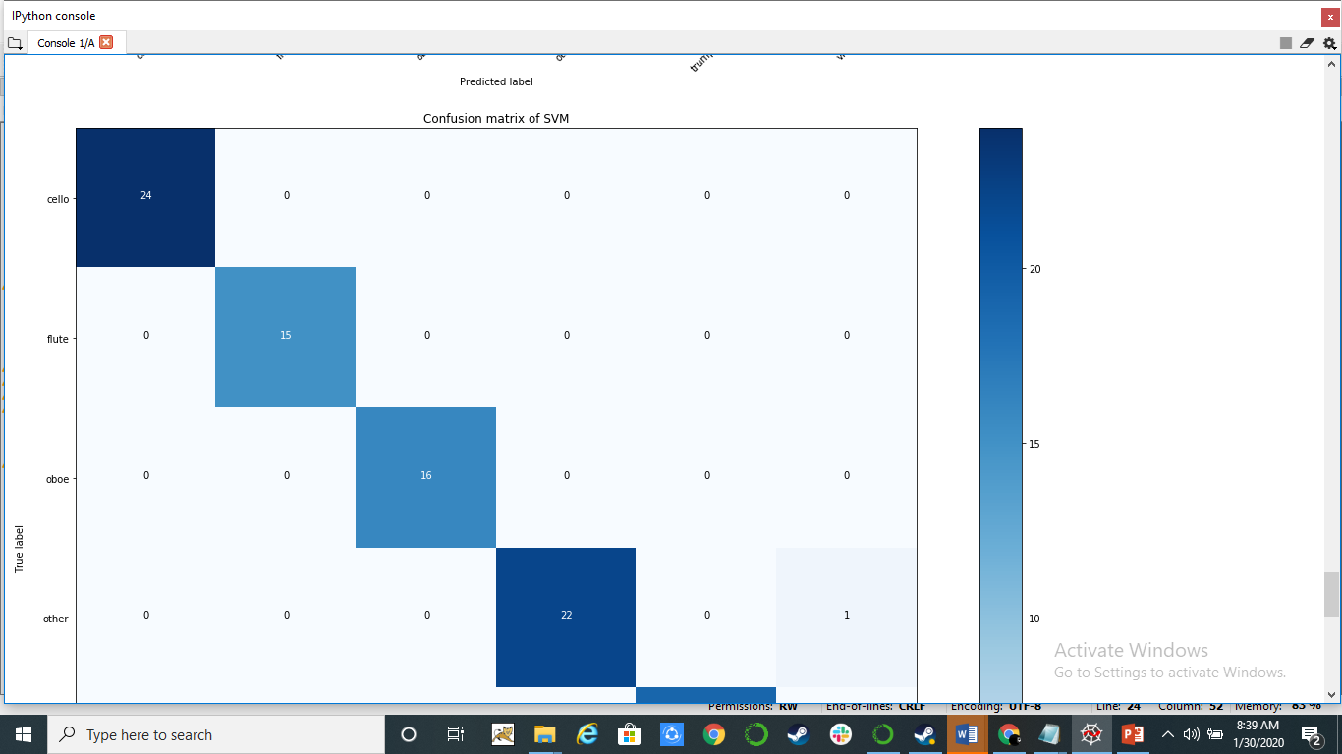

Slide 16
Thank You.

